Slide 1
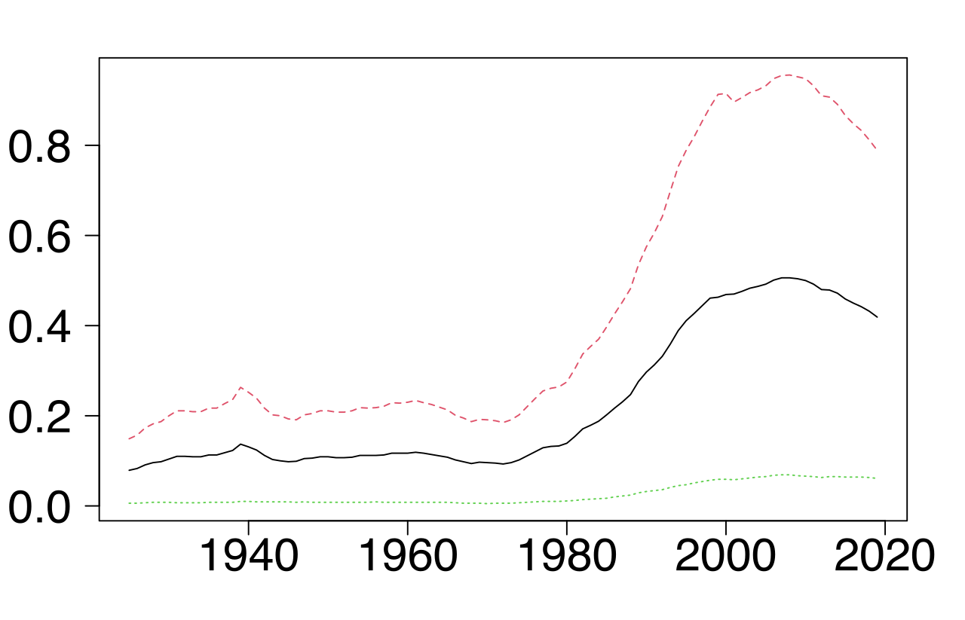

Slide 2
Geography of crime
Crime rates vary in the United States depending on the type of community. Within metropolitan statistical areas, both violent and property crime rates are higher than the national average.

Slide 3
in cities located outside metropolitan areas, violent crime was lower than the national average, while property crime was higher. For rural areas, both property and violent crime rates were lower than the national average.

Slide 4
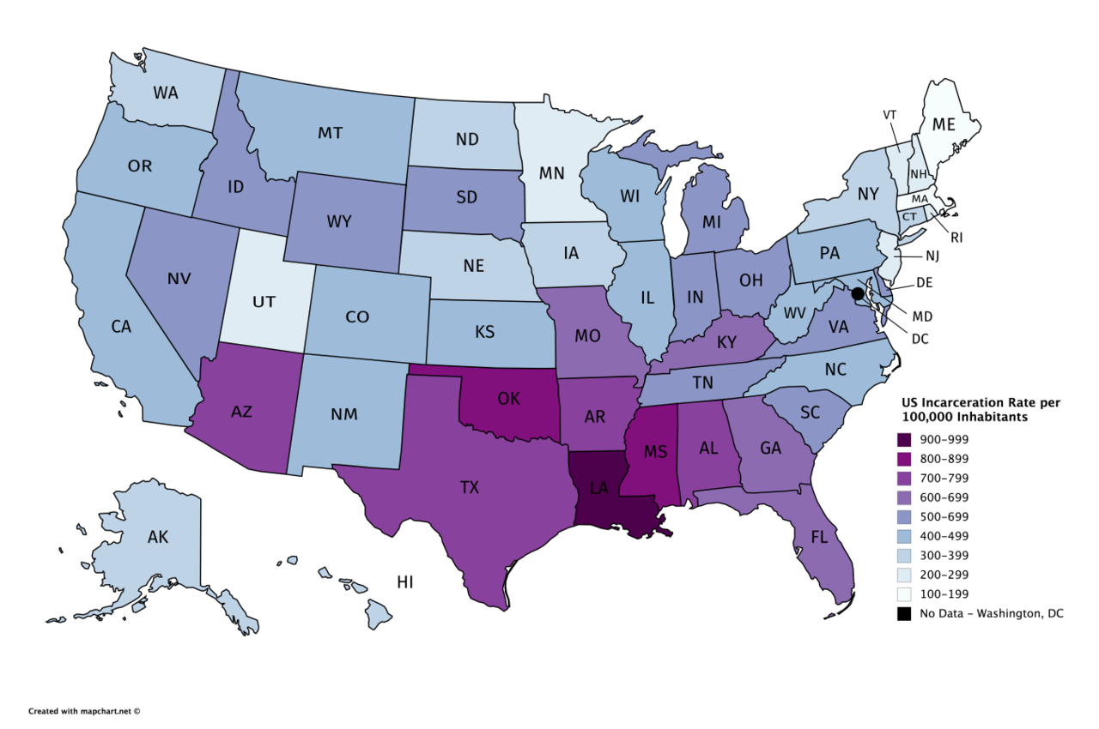

Slide 5
state | Per100,000 All ages | Per100,000 adults | Adults in prison or jail
Louisiana | 980 | 1,280 | 45,700
Oklahoma | 970 | 1,290 | 38,500
Mississippi | 920 | 1,210 | 27,500
Georgia | 850 | 1,110 | 89,700
Kentucky | 840 | 1,080 | 37,500

Slide 6
state | Per100,000 All ages | Per100,000 adults | Adults in prison or jail
Minnesota | 280 | 370 | 15,900
District of Columbia | 260 | 310 | 1,800
Rhode island | 260 | 320 | 2,800
Vermont | 260 | 320 | 1,700
Massachusetts | 250 | 320 | 17,600

Slide 7
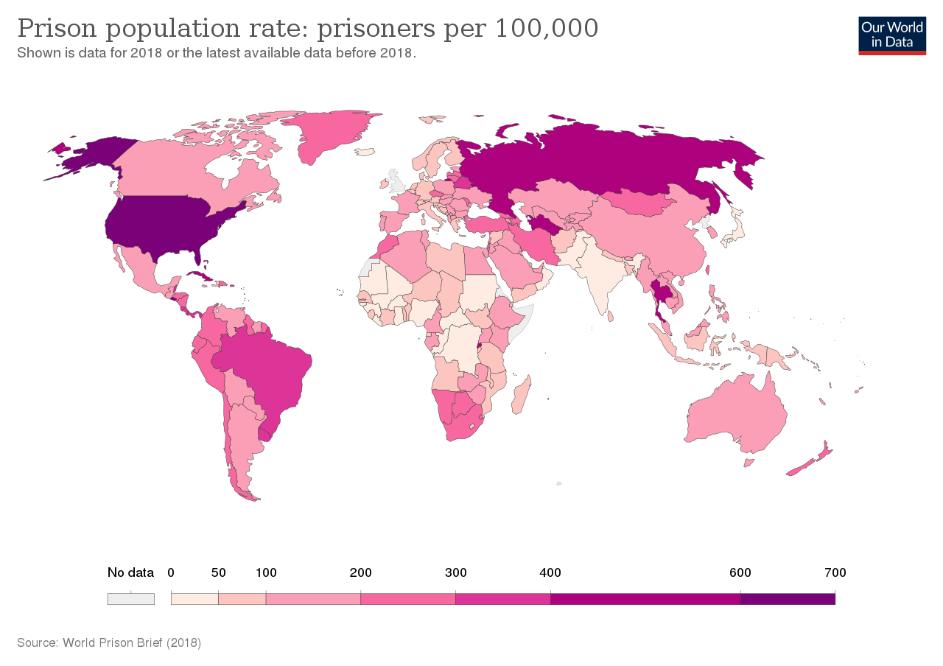

Slide 8
Incarceration rate per 100,000
US 639
El Salvador 572
Turkmenistan 552
Rwanda 511
Cuba 510
Maldives 499
Thailand 449
San Marino 6
Central Africa 16
Norway 49
Dr Congo 29
Nigeria 32
Monaco 21
Japan 38
India 35
China 121

Slide 9
"What was Bob Greene's talent? He arrived at a point of view on common, everyday issues, and he expressed it in a way that obviously a huge bunch of readers in the country would look at and say, ‘I agree with that. That's exactly the way I feel.' And that is a talent. That is a great talent."

Slide 10
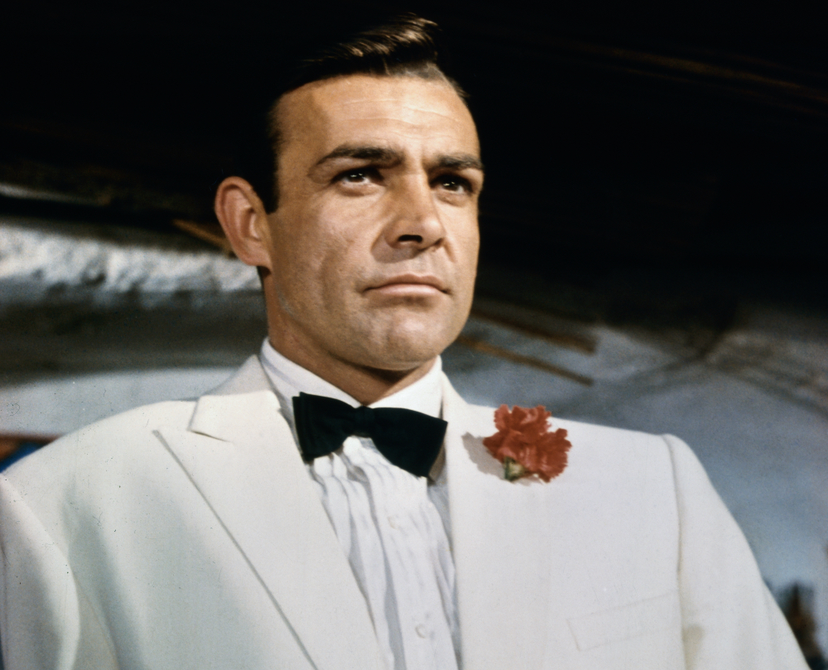

Slide 11
In 1972, after the murder of 11 Israeli athletes at the Munich Olympics, Greene published a striking column that secured his reputation nationally. "It took this one night to make us know" what it is to be a Jew, he wrote.

Slide 12
When I visit [my parents] I often make excuses to go into another room and read a magazine, or put a record on the stereo; for whatever reason, I find it hard to just talk and sit around and be close."

Slide 13
"You Wouldn't Want to Be Bob Greene.“
"he is the master of the tug at cheap emotion, the king of cloaking a banal observation in fake profundity."

Slide 14
They were basically women, 25 to 50, who spent the money and bought the products. He was the darling of that crowd. He wrote with a kind of Midwestern point of view, a sensible point of view. He had a good grasp for family, for children, all subjects that that group was interested in."

Slide 15
"Susan was a person of never-ending good-heartedness, charity and mercy."

Slide 16
sentimentality
A sentimentalist, is one who desires to have the luxury of an emotion without paying for it.
Oscar Wilde

Slide 17
Sentimentality, the ostentatious parading of excessive and spurious emotion, is the mark of dishonesty, the inability to feel...the mask of cruelty.
James Baldwin

Slide 18
The sentimental person thinks things will last—the romantic person has a desperate confidence that they won't.
F. Scott Fitzgerald

